Slide 1
Power BI Embedded
FSI CSU SWARM

Slide 2
Resources

Slide 3
Abstract and learning objectives
Resources for Power BI Embedded

Slide 4
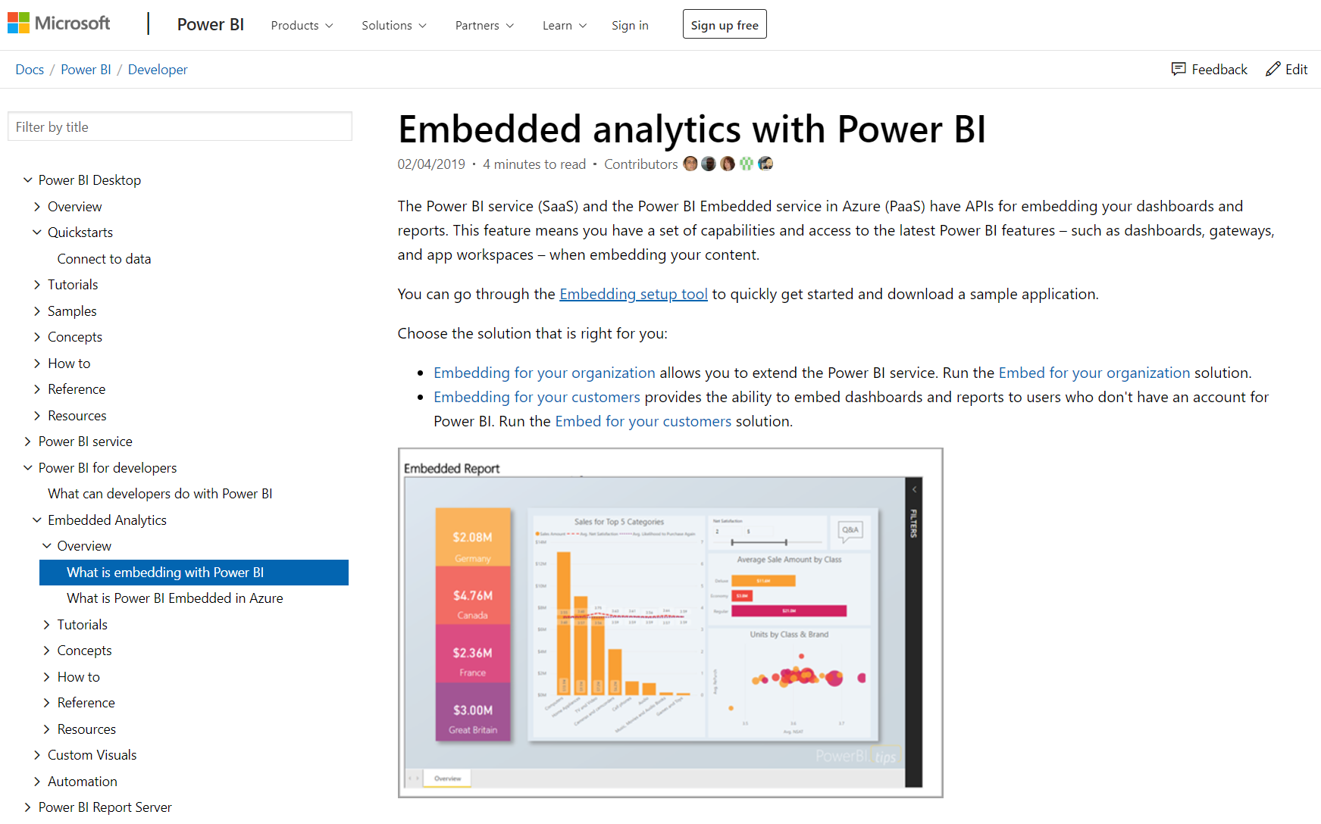
Azure Docs
Azure Docs Power BI Embedded

Slide 5
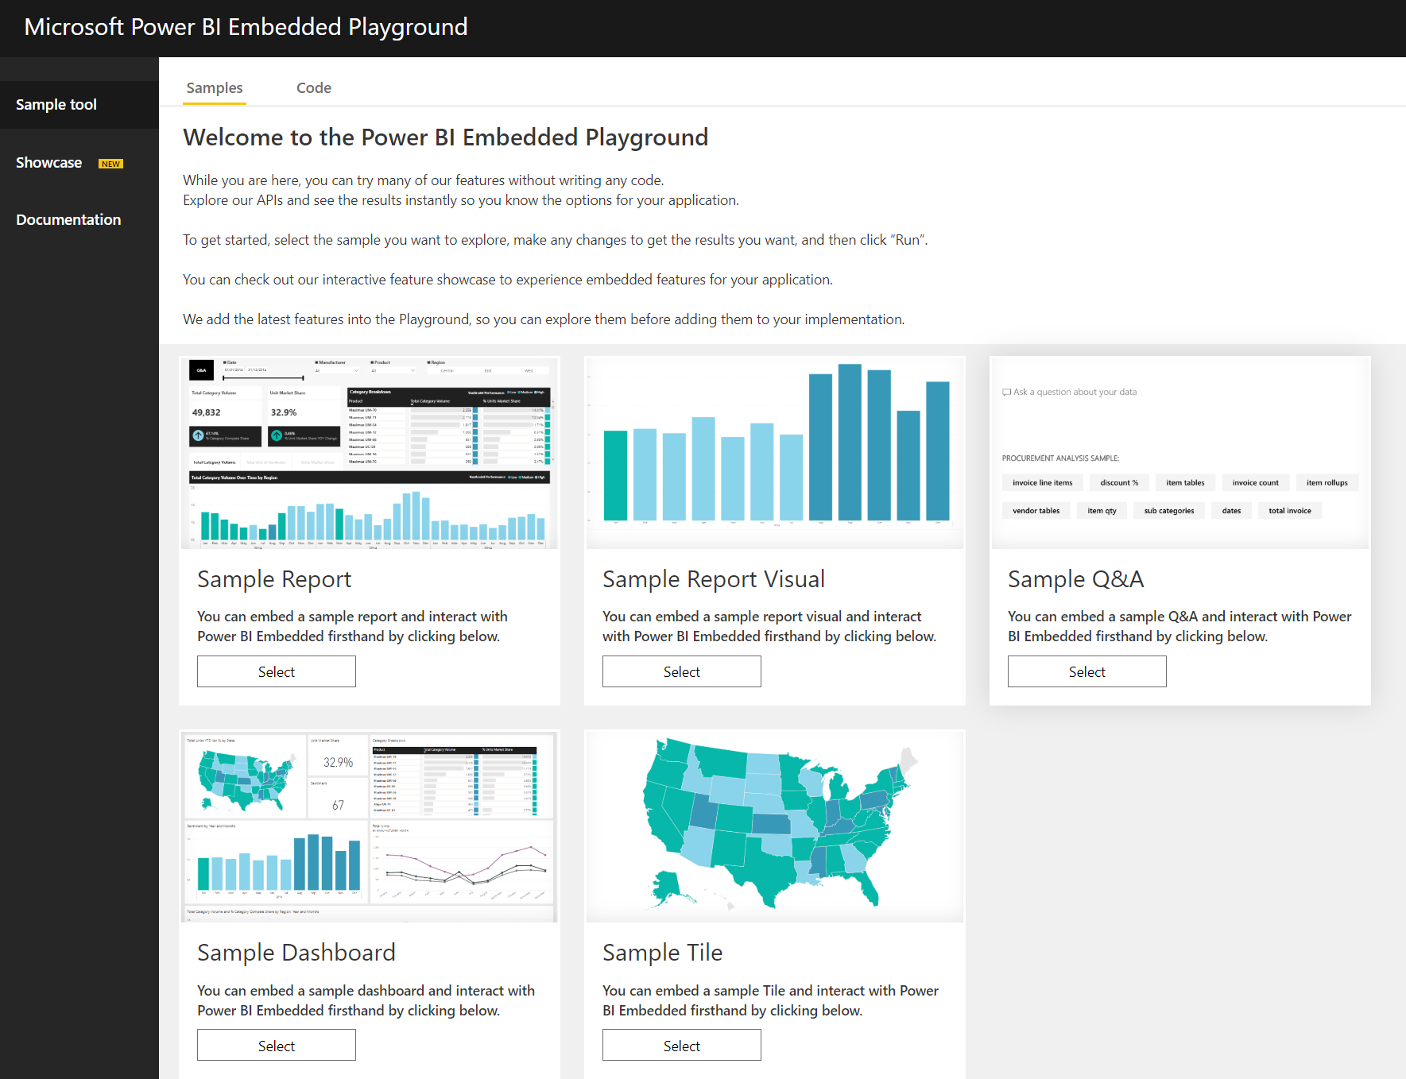
Embedded Playground
Power BI Embedded - JavaScript Demo

Slide 6
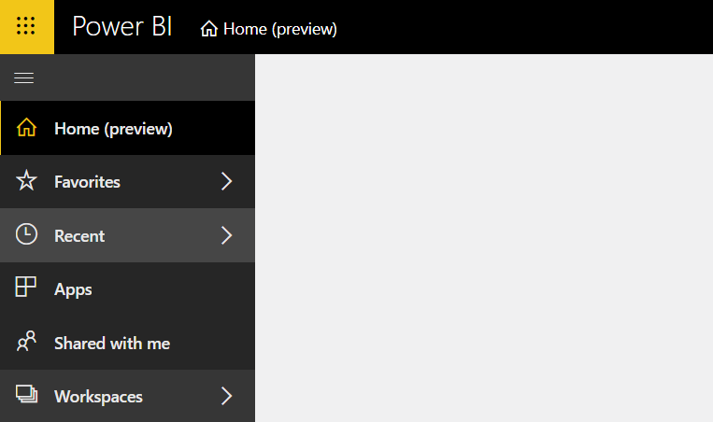
Application Portal
App Portal

Slide 7
Communities
Communities: Ask Power BI questions
Power BI Ideas: Request and vote for features
Reddit: Discuss Power BI

Slide 8
Wrap Up

